Slide 1
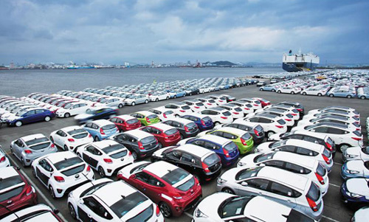
EDA of Car Sales

Slide 2
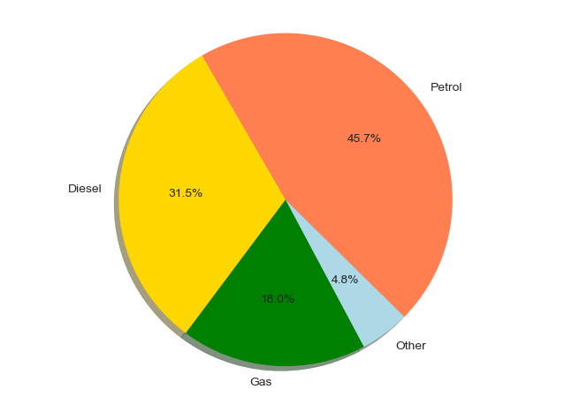
Which Engine Type (fuel type) cars are sold highest and lowest?
Petrol cars hold the highest percentage in sale followed by Diesel cars and Gas cars.

Slide 3
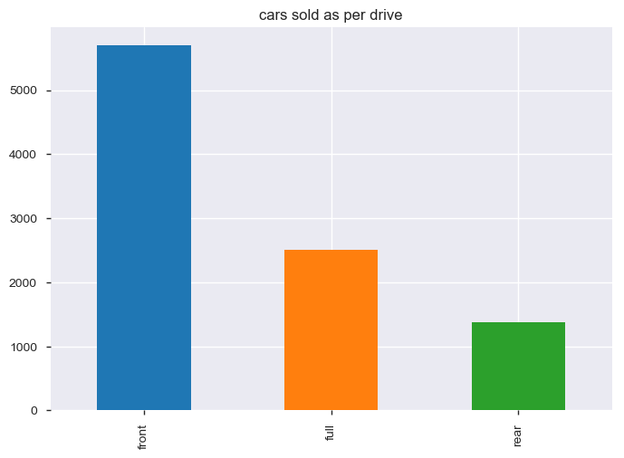
Which Cars are sold highest and lowest based on wheel drive type (Front/ Full/ Rear wheel drive)?
Front wheel cars are sold highest and rear wheel are least sold.

Slide 4
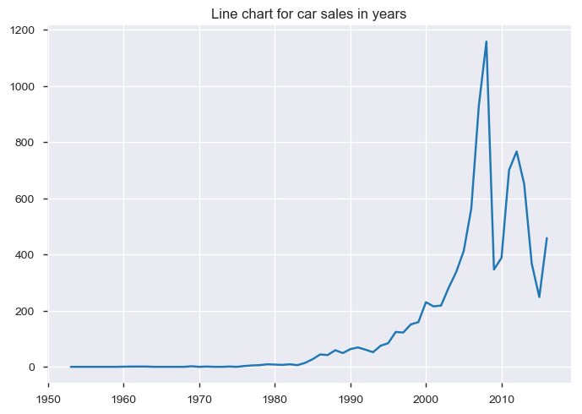
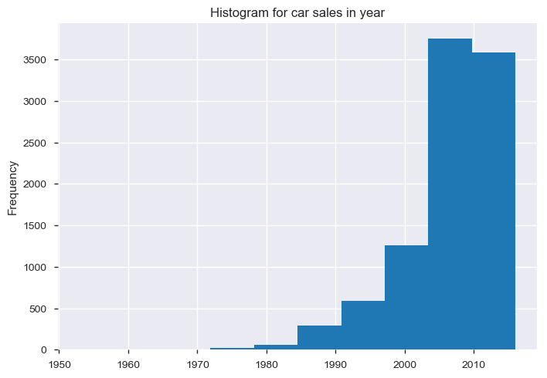
When is the maximum number of cars sold?
The above graph indicates least sale of cars is between 1953 and 1982 (approx). Highest sale of cars is between 2000 and 2010, and seems to be in 2008.

Slide 5
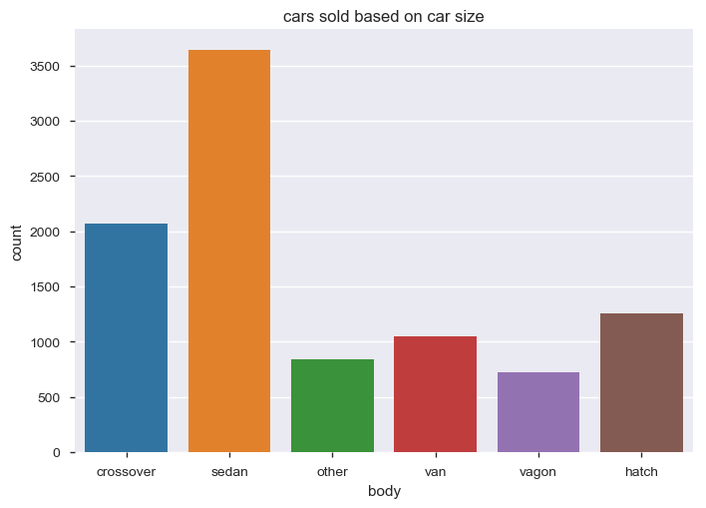
Which cars are sold maximum and minimum based on car size?
Sedan cars has highest sale followed by crossover, vagon is the least sold car model.

Slide 6
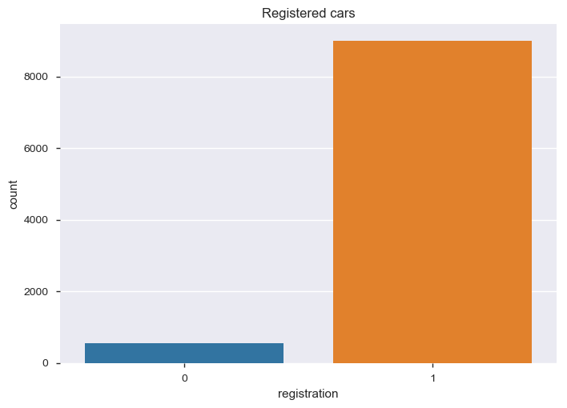
What is the maximum number of registered cars?
Number of cars registered is quite high, and not registered is very less. There could be a possibility that the car is registered in some other country for 'no' being very less.

Slide 7
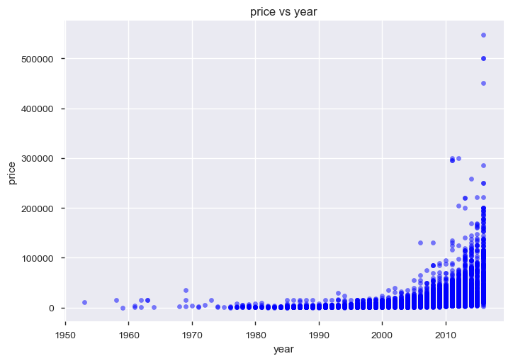
How much is increase in price of car w.r.t time as per year?
Price of car is low between 1953 and 1995; price has gradually increased from year 2000. There are some outliers from 2007(approx) onwards. After 2011 the prices have gone very high.

